Slide 1
Machine Learning (ML) RIME-832
Dr. Muhammad Jawad Khan

Slide 2
Fundamentals of Machine Learning

Slide 3
History
How to move from point A to B?
Photo tagging
Spam/anti-spam labeling
Web search
Autonomous car
Hand writing recognition
Computer vision
Credit card fraud detection
Language translation
Product recommendations …..

Slide 4
Volume of data collected growing day by day
Data production will be 44 times greater in 2020 than in 2009
Every day, 2.5 quintillion bytes of data are created, with 90 percent of world data created in past 5 years
Humans will only be able to look at only a portion of the entire data
Data is cheap and abundant; knowledge is scarce and expensive
Knowledge discovery is NEEDED to make sense and use of data

Slide 5
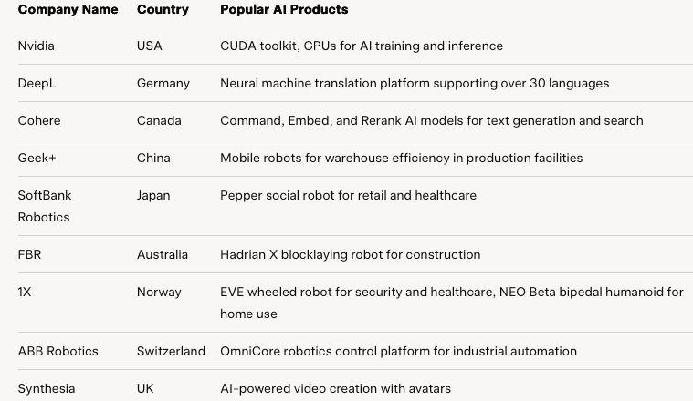
AI Companies

Slide 6
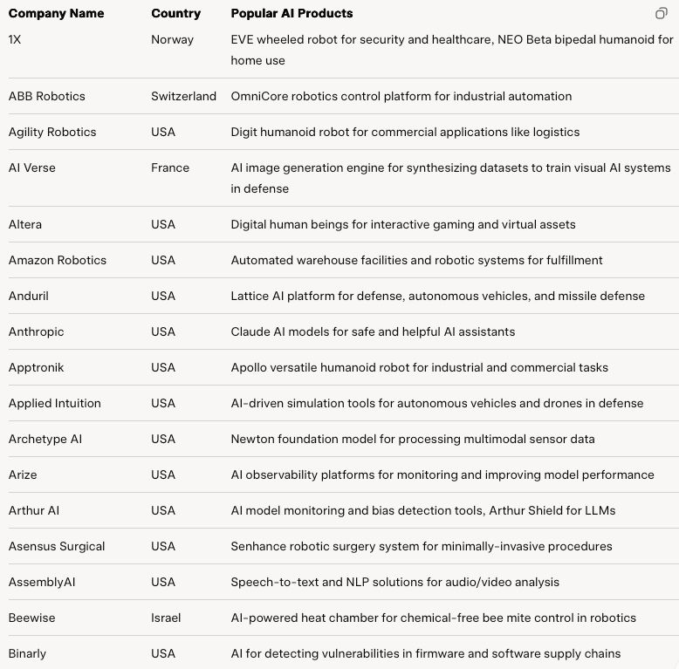

Slide 7
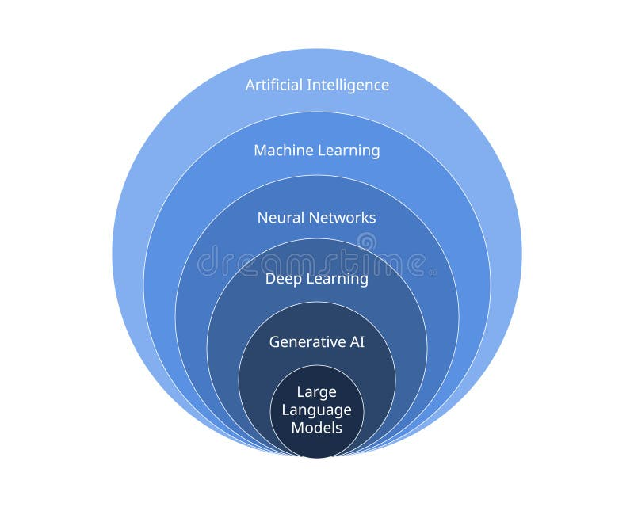
AI Onion
https://www.dreamstime.com/illustration/subset.html

Slide 8
What is ML?
Machine Learning is the science (and art) of programming computers so they can learn from data.
Field of study that gives computers the ability to learn without being explicitly programmed.

Slide 9
Engineering Approach
A computer program is said to learn from experience E with respect to some task T and some performance measure P, if its performance on T, as measured by P, improves with experience E.
Tom Mitchell, 1997

Slide 10
Some Deifinitions
The examples that the system uses to learn are called the training set
Each training example is called a training instance (or sample)
The task T is to flag spam for new emails, the experience E is the training data, and the performance measure P needs to be defined; for example, you can use the ratio of correctly classified emails. This particular performance measure is called accuracy and it is often used in classification tasks.

Slide 11
Why Use Machine Learning?
Write a spam filter using traditional programming techniques:
1. First you would look at what spam typically looks like.
2. You would write a detection algorithm for each of the patterns that you noticed, and your program would flag emails as spam if a number of these patterns are detected.
3. You would test your program, and repeat steps 1 and 2 until it is good enough.

Slide 12
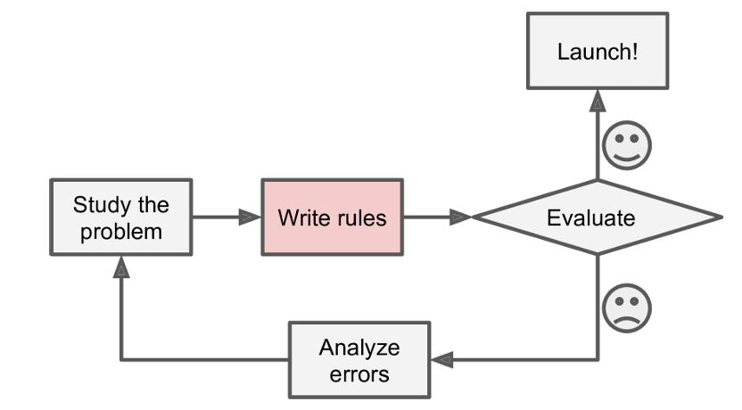
The problem is not trivial, your program will likely become a long list of com plex rules—pretty hard to maintain

Slide 13
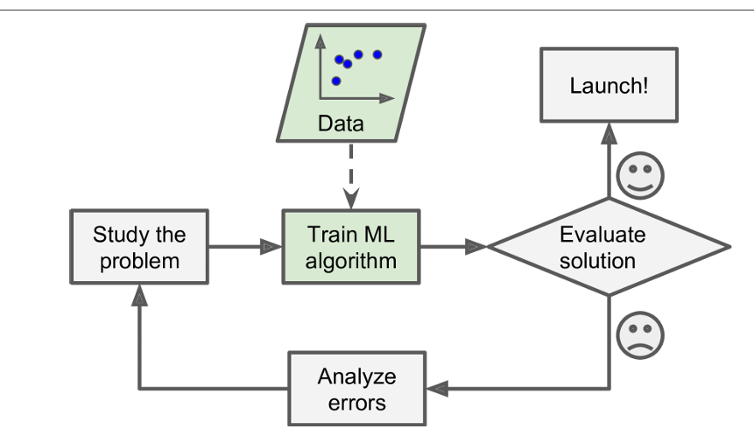
Machine Learning Approach
Making decision based on available data

Slide 14
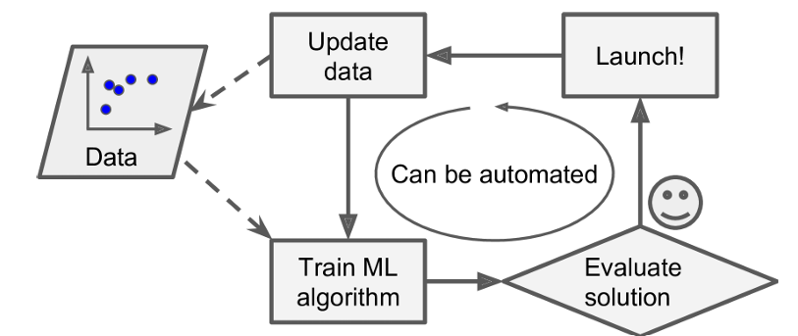
Adapting to Change

Slide 15
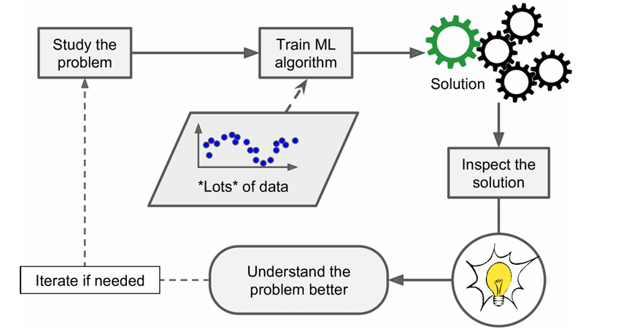
For Complex Problems

Slide 16
Machine Learning is Good for:
Problems for which existing solutions require a lot of hand-tuning or long lists of rules: one Machine Learning algorithm can often simplify code and perform bet ter.
Complex problems for which there is no good solution at all using a traditional approach: the best Machine Learning techniques can find a solution.
Fluctuating environments: a Machine Learning system can adapt to new data.
Getting insights about complex problems and large amounts of data.

Slide 17
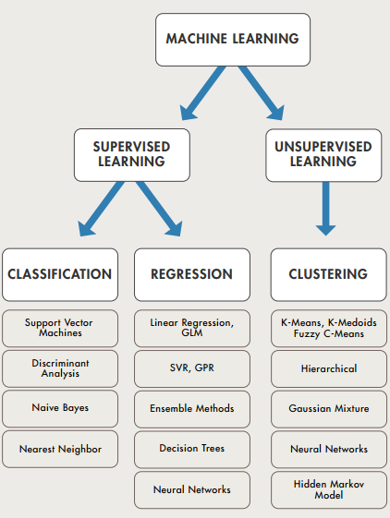
Types of Machine Learning

Slide 18
Supervised learning
In supervised learning, the training data you feed to the algorithm includes the desired solutions, called labels
A class is a category or label that a supervised learning model is trained to predict, such as "cat" or "dog" in an image classification task.
A feature is an individual, measurable property or characteristic of a phenomenon being observed. In a dataset, features are the columns that represent the attributes of the data. For example, in a dataset of houses, features might be the number of bedrooms, square footage, and year built.
The target is the variable a machine learning model is trying to predict. It's also known as the label or dependent variable. For example, in a model predicting house prices, the target would be the price of the house. In classification tasks, the target is the class label, and in regression tasks, it's a continuous value.

Slide 19
Term | Definition | Example
Class | A category or group that a sample belongs to in a classification problem. | In a spam email classifier, classes could be "Spam" or "Not Spam."
Feature | An individual measurable property or characteristic of a sample. | In an email dataset, features could include "word count" or "sender domain."
Label | The output or target variable assigned to a sample, often the class it belongs to in classification. | For an email sample, the label might be "Spam" or "Not Spam."
Sample | A single instance or data point in a dataset, consisting of features and a label/target. | A single email with its word count, sender domain, and spam/not spam label.
Target | The variable to be predicted, which can be a class (in classification) or a continuous value (in regression). | In a spam classifier, the target is "Spam" or "Not Spam"; in a house price predictor, the target is the price (e.g., $300,000).

Slide 20
Sample | Class | Label | Feature | Target
A review with 50 words, sentiment score 0.8, labeled "Positive" | Positive, Negative | Positive | Word count, Sentiment score | Positive
An email from "unknown.com", 200 words, labeled "Spam" | Spam, Not Spam | Spam | Sender domain, Email length | Spam
An animal with brown fur, floppy ears, labeled "Dog" | Cat, Dog | Dog | Fur color, Ear shape | Dog
A day with 25°C temperature, 60% humidity, labeled "Medium" | Low, Medium, High | Medium | Temperature, Humidity | Medium
A stock with price $100, volume 10,000 shares, labeled "Buy" | Buy, Sell, Hold | Buy | Stock price, Trading volume | Buy
A house with 1500 sq ft, 3 rooms, target price $250,000 | 0-100 (numeric) | 250,000 | Square footage, Number of rooms | 250,000
A vehicle with 4 wheels, 1500kg weight, labeled "Car" | Car, Motorcycle | Car | Number of wheels, Weight | Car

Slide 21
A typical supervised learning task is classification.
Task is to predict a target numeric value, given a set of features called predictors. This sort of task is called regression
An attribute is a data type (e.g., “Class A” or “Class B”), while a feature has several meanings depending on the context, but generally means an attribute plus its value (e.g., “Class A = 15,000”). Many people use the words attribute and feature inter changeably

Slide 22
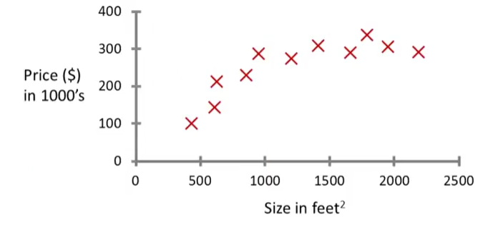
Supervised Learning
Most common type of ML
Motivational housing price prediction:
Classification or regression.
Why it is supervised?

Slide 23
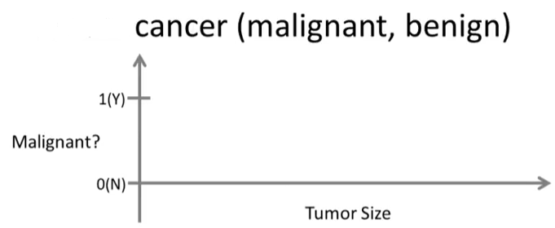
Supervised Learning
Another Example

Slide 24
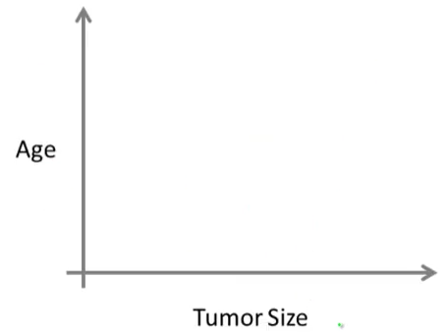
Supervised Learning
How does more features help?

Slide 25
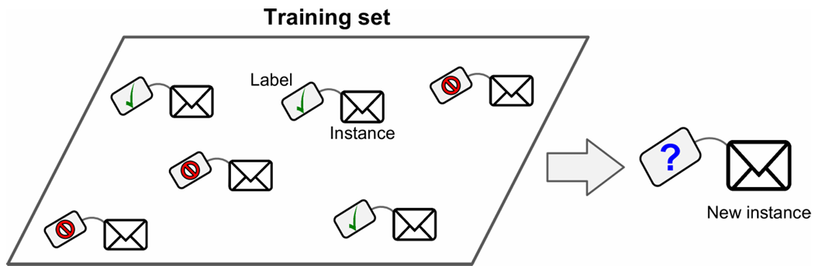
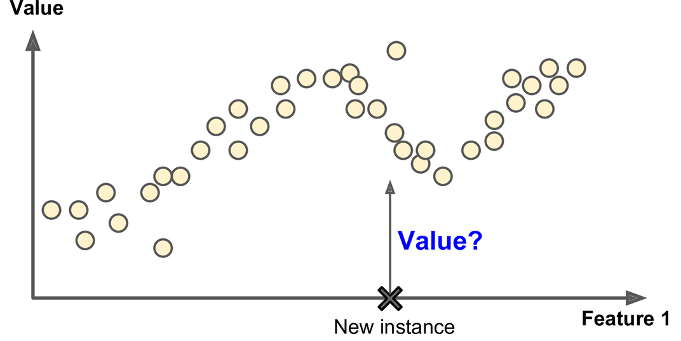
Classification vs Regression
Classification
Regression

Slide 26
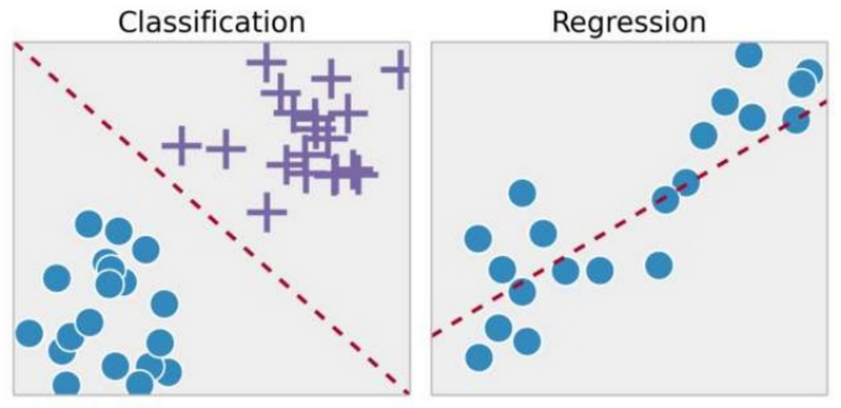
Classification vs Regression

Slide 27
Supervised Learning Algorithms
k-Nearest Neighbors
Linear Regression
Logistic Regression
Support Vector Machines (SVMs)
Decision Trees and Random Forests
Neural networks

Slide 28
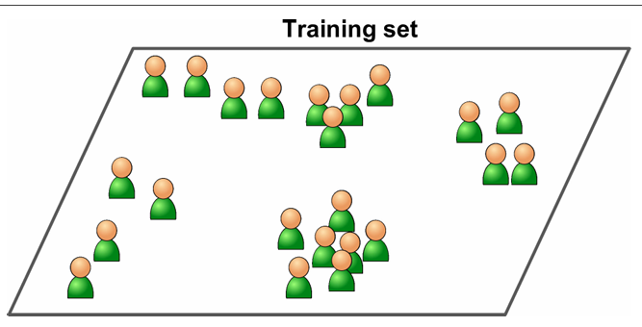
Unsupervised learning
In unsupervised learning, the training data is unlabeled. The system tries to learn without a teacher

Slide 29
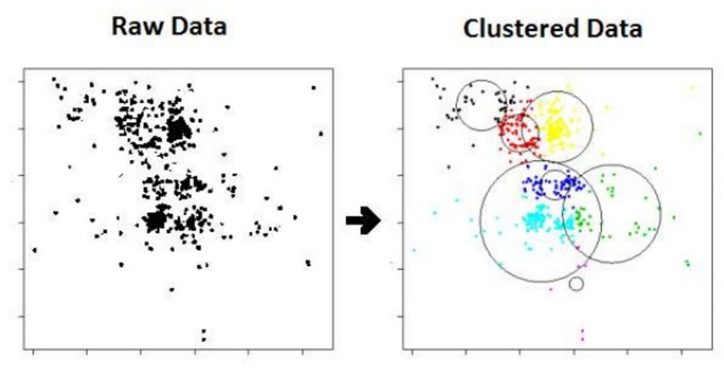
Unsupervised Learning
Concept
Finds inherent data structure

Slide 30
Unsupervised Algorithms
Clustering
—K-Means
—DBSCAN
—Hierarchical Cluster Analysis (HCA)
Anomaly detection and novelty detection
—One-class SVM
—Isolation Forest
—Neurla Networks (e.g. Auto encoders)
Visualization and dimensionality reduction
—Principal Component Analysis (PCA)
—Kernel PCA
—Locally-Linear Embedding (LLE)
—t-distributed Stochastic Neighbor Embedding (t-SNE)
Association rule learning
—Apriori
—Eclat

Slide 31
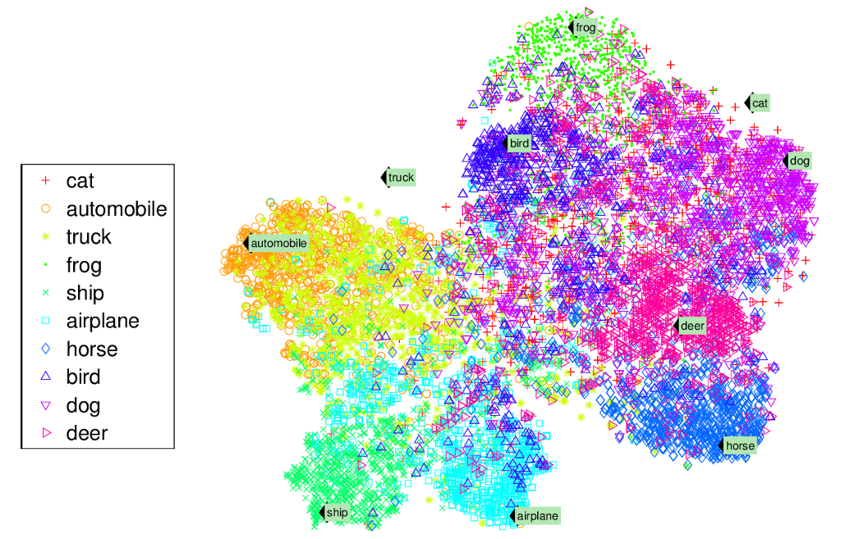
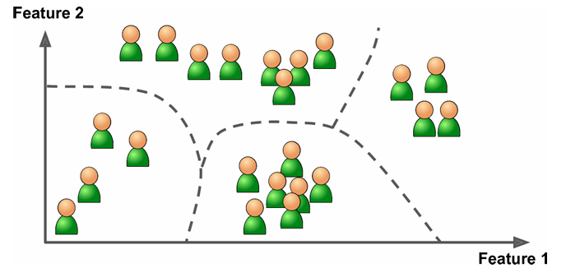
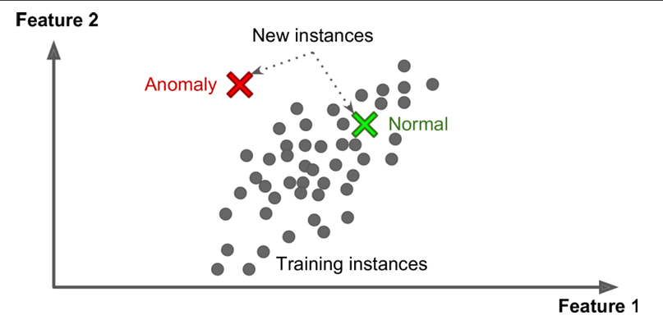
Clustering
Visualization and dimensionality reduction
Anomaly detection and novelty detection

Slide 32
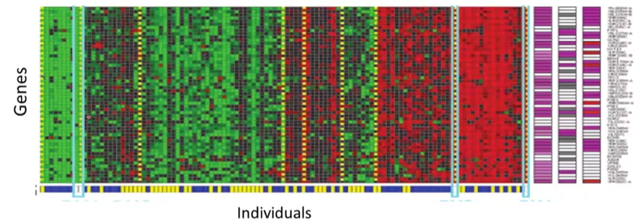
Unsupervised Learning
Google news example
Genomics example: If an individual has a certain type of gene or not.
Market Segmentation

Slide 33
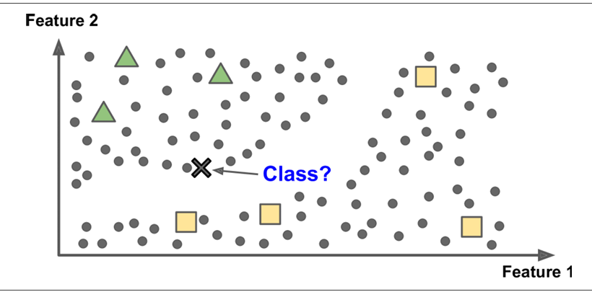
Semisupervised learning
Partially labeled training data, usually a lot of unlabeled data and a little bit of labeled data. This is called semisupervised learning

Slide 34
Reinforcement Learning
The learning system, called an agent in this context, can observe the environment, select and perform actions, and get rewards in return (or penalties in the form of negative rewards)
It must then learn by itself what is the best strategy, called a policy, to get the most reward over time. A policy defines what action the agent should choose when it is in a given situation

Slide 35
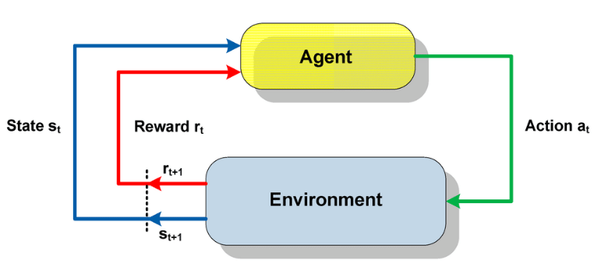
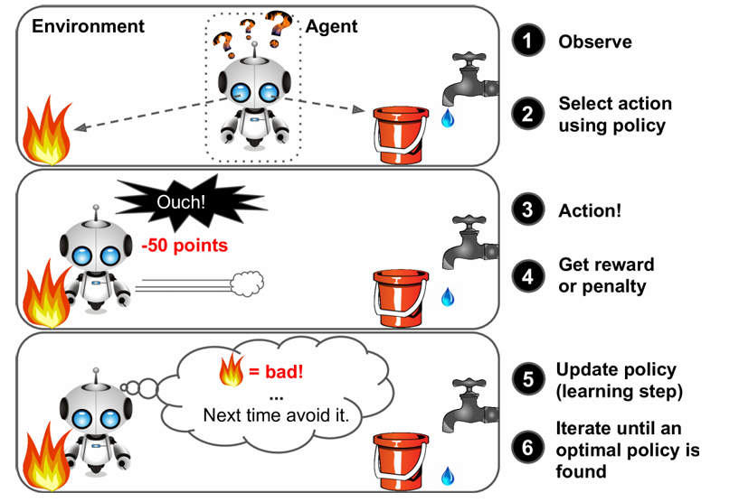
https://www.researchgate.net/figure/A-brief-schema-of-Reinforcement-Learning-26_fig3_318931340

Slide 36
Batch and Online Learning
Another criterion used to classify Machine Learning systems is whether or not the system can learn incrementally from a stream of incoming data.

Slide 37
Batch learning
In batch learning, the system is incapable of learning incrementally: it must be trained using all the available data.
This will generally take a lot of time and computing resources, so it is typically done offline.
First the system is trained, and then it is launched into production and runs without learning anymore; it just applies what it has learned. This is called offline learning

Slide 38
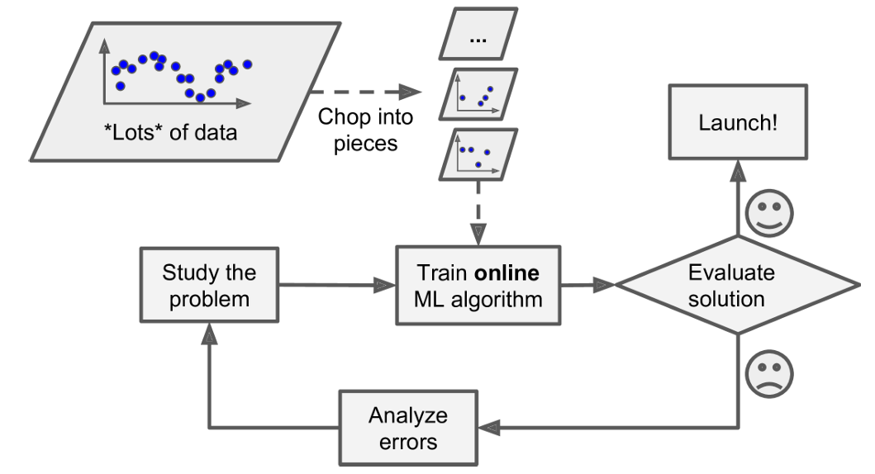
Online learning
In online learning, you train the system incrementally by feeding it data instances sequentially, either individually or by small groups called mini-batches.
Each learning step is fast and cheap, so the system can learn about new data on the fly

Slide 39
Batch vs Online Learning Examples
Example | Batch Learning | Online Learning
Email Spam Filter | Train a model on a large dataset of labeled emails (spam/not spam) all at once. | Continuously update the model as new emails arrive, adapting to new spam patterns.
Image Classification | Train a neural network on a fixed dataset of labeled images (e.g., ImageNet). | Update the model incrementally as new images are labeled and added over time.
Stock Price Prediction | Use historical stock data from the past year to train a predictive model. | Update the model daily with new stock prices to refine predictions.
Recommendation System | Build a model using a complete dataset of user interactions (e.g., movie ratings). | Adapt recommendations in real-time as users interact with the system.
Credit Risk Assessment | Train a model on a dataset of past loan applications and their outcomes. | Update the model as new loan applications and repayment data are received.

Slide 40
Instance-Based Versus Model-Based Learning
One more way to categorize Machine Learning systems is by how they generalize.
Given a number of training examples, the system needs to be able to generalize to examples it has never seen before
Having a good performance measure on the training data is good, but insufficient; the true goal is to perform well on new instances

Slide 41
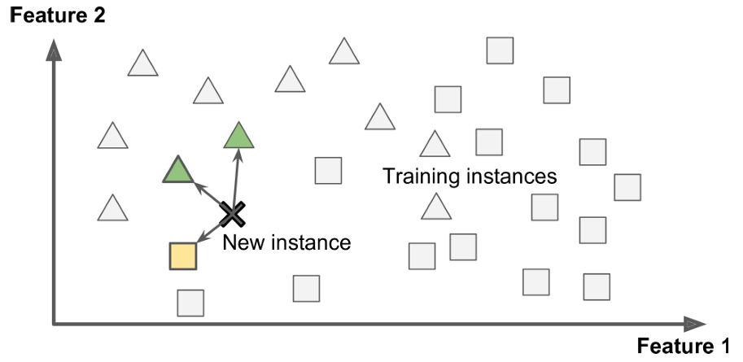
Instance-based learning
The system learns the examples by heart, then generalizes to new cases by comparing them to the learned examples (or a subset of them), using a similarity measure.

Slide 42
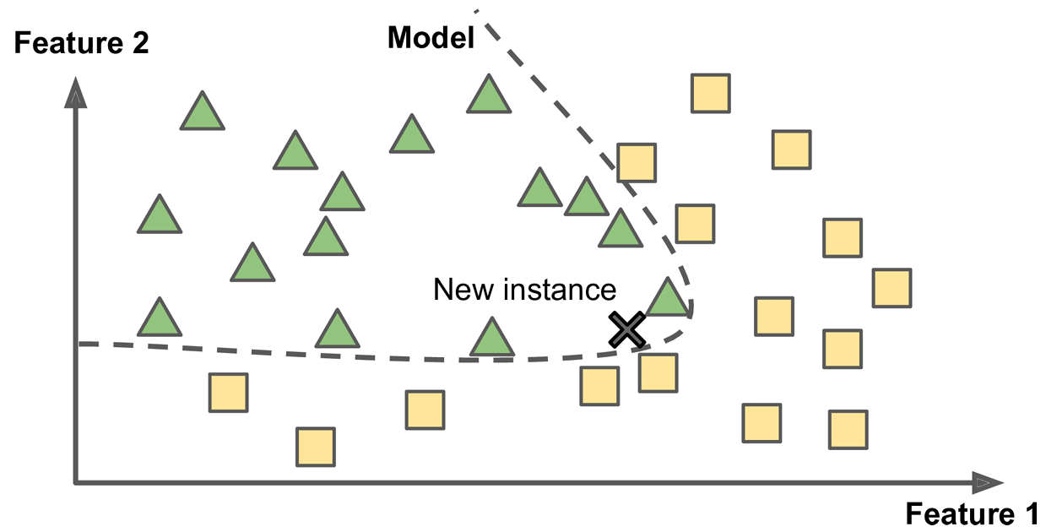
Model-based learning
Another way to generalize from a set of examples is to build a model of these examples, then use that model to make predictions.

Slide 43
Instance vs Model Based Learning Examples
Example | Instance-Based Learning | Model-Based Learning
Email Spam Filter | Classify emails as spam/not spam by comparing them to stored examples of labeled emails using k-NN. | Train a logistic regression model on labeled emails to predict spam probability.
Image Classification | Identify image categories by finding the most similar labeled images in a dataset (e.g., using k-NN). | Train a convolutional neural network to learn features and classify images.
Stock Price Prediction | Predict stock prices by finding similar historical patterns using nearest neighbors. | Train a regression model (e.g., linear regression) on historical data to predict prices.
Recommendation System | Recommend items by finding users with similar preferences based on stored user data. | Train a matrix factorization model to predict user preferences for items.
Credit Risk Assessment | Assess risk by comparing new loan applications to similar past applications. | Train a decision tree model on past loan data to predict default probability.

Slide 44
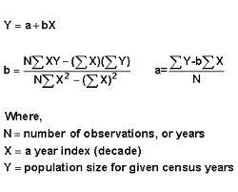
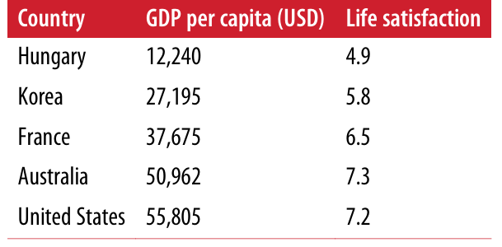
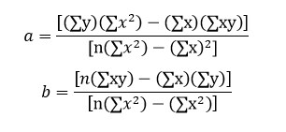
Example
Suppose you want to know if money makes people happy, so you download the Better Life Index data from the OECD’s website as well as stats about GDP per capita from the IMF’s website. Then you join the tables and sort by GDP per capita.

Slide 45
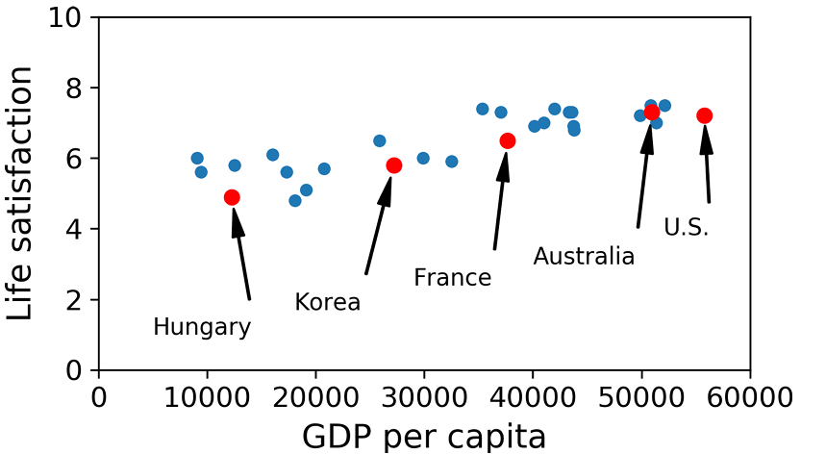
Although the data is noisy (i.e., partly random), it looks like life satisfaction goes up more or less linearly as the country’s GDP per cap ita increases. So you decide to model life satisfaction as a linear function of GDP per capita.
This step is called model selection: you selected a linear model of life satisfaction with just one attribute, GDP per capita

Slide 46
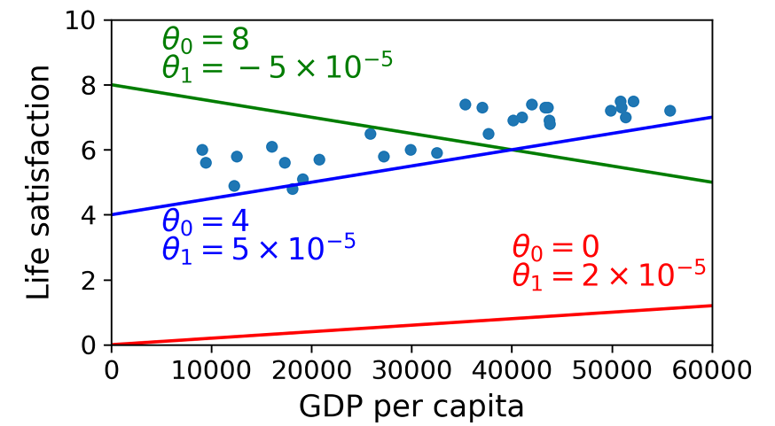
A simple linear model
life_satisfaction = θ0 + θ1 × GDP_per_capita
This model has two model parameters, θ0 and θ1, By tweaking these parameters, you can make your model represent any linear function

Slide 47


Linear Regression with ONE variable
Formally, we can find θ₀ and θ₁ by using the following cost function:
Where are the parameters θ₀ and θ₁ in the equation?
Loss known as squared error function (most common for regression problems)

Slide 48
Linear Regression with ONE variable
Summary
Hypothesis
h_{θ}(x) = θ₀+ θ₁x
Parameters
θ₀,θ₁
Cost Function
Goal

Slide 49
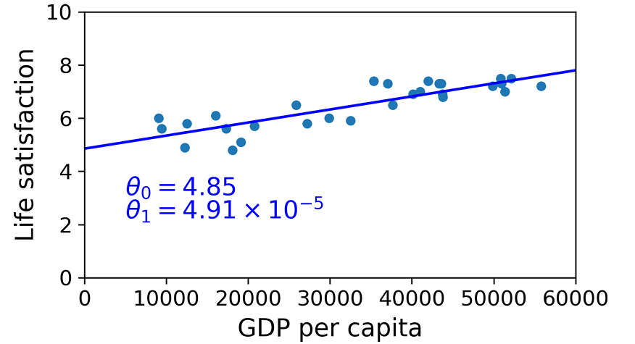
You feed it your training examples and it finds the parameters that make the linear model fit best to your data. This is called training the model. In our case the algorithm finds that the optimal parameter values are θ0 = 4.85 and θ1 = 4.91 × 10–5.

Slide 50
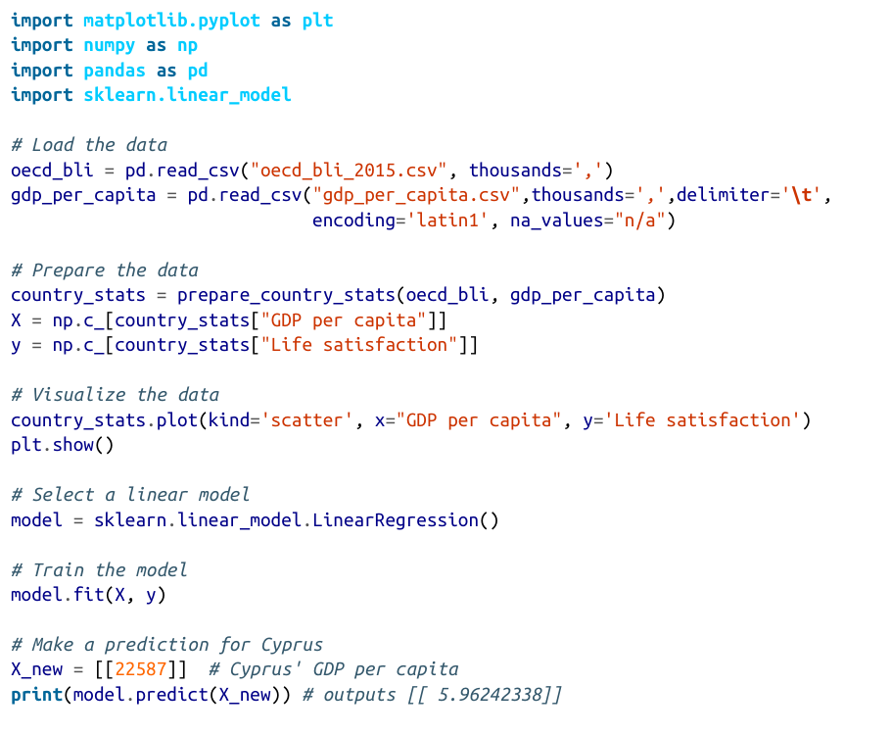
Implementation in Python

Slide 51
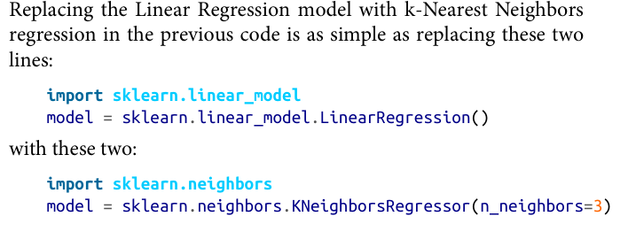

Slide 52
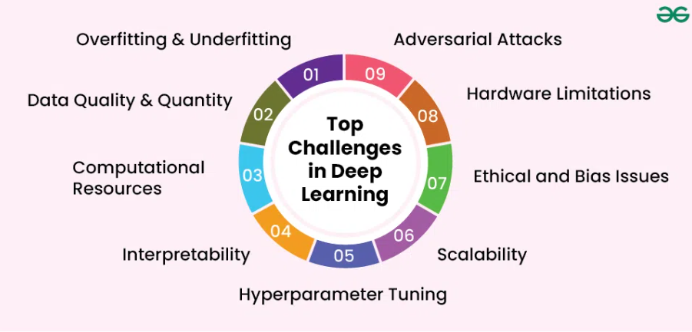
Main Challanges
Insufficient Quantity of Training Data
The Unreasonable Effectiveness of Data
Nonrepresentative Training Data
Ethical issues and Sampling Bias
Poor-Quality Data
Irrelevant Features
Overfitting the Training Data
Underfitting the Training Data
Testing and Validating
Hyperparameter Tuning and Model Selection
Data Mismatch
https://www.geeksforgeeks.org/deep-learning/challenges-in-deep-learning/

